Slide 1

UNDERSTANDING SHORT TEXTS THROUGH SEMANTIC ENRICHMENT AND SEMANTIC HASHING
Batch No: B-09 Project Guide:
Ramya S (164G1A0575) Mr. T. Murali Krishna _{MCA, M. Phil, M. Tech, (PhD)}
Rekha G (164G1A0579) Assistant professor
Ramya Sai N (164G1A0576 )
Sai kiran K (164G1A0586)
Rama Mohan Chowdary K (164G1A0574)
Srinivasa Ramanujan Institute of Technology
Department of Computer Science & Engineering

Slide 2
Introduction
In present world a wide range of applications handle short text.
For example, news recommendation system needs to process the news titles which may be not strictly syntactical; in web search, queries consist of a very small number of keywords
In this project we facilitate short text understanding by enriching the short text representations.

Slide 3
Existing System
Many applications have been proposed to facilitate short text understanding by enriching the short text.
The lack of sufficient statistical information leads to difficulties in effectively measuring similarity, and as a result, many existing text analytics algorithms do not apply to short texts directly.
Semantic hashing models are used for understanding short text.

Slide 4
Proposed System
We present a novel mechanism to semantically enrich short texts with both concepts and co-occurring terms.
For this we cluster the short text by their meaning.
We show significant improvements over existing approaches, which confirm that concepts and co-occurring terms effectively enrich short texts, and enable better understanding of them.

Slide 5
Abstract
Understanding short texts retrieval, classification and processing became a very difficult task.
Clustering short texts (such as news titles) by their meaning is a challenging task.
The semantic hashing approach encodes the meaning of a text into a compact binary code.

Slide 6
Contd..
Thus, to tell if two texts have similar meanings, we only need to check if they have similar codes.
To cluster short texts by their meanings, we propose to add more semantics to short texts.
For each term in a short text, we obtain its concepts and co-occurring terms from a database to enrich the short text.

Slide 7
Problem Statement
Short texts introduce new challenges to many text related tasks including information retrieval (IR), classification, and clusterings, two short texts that have similar meaning For example, the meanings of “upcoming apple products” and “new iphone and ipad” are closely related, but they share no common words.
The word “apple” gives rise to different meanings in “apple product” and “apple tree”. Due to the scarcity of contextual information, these ambiguous words make short texts hard to understand by machines.

Slide 8
Module Description
Admin Module:
Admin will be permitted to login and will have the permission to manipulate the data base.
Admin will have the permissions to upload the files and images into the data base where these information will be viewed by the user when searched.

Slide 9
User Module:
User can login through this and search for the query, retrieve the information.
If the user login credentials are wrong the access will be denied.
New user will be provided with a registration form to register and then can login to retrieve the information.

Slide 10
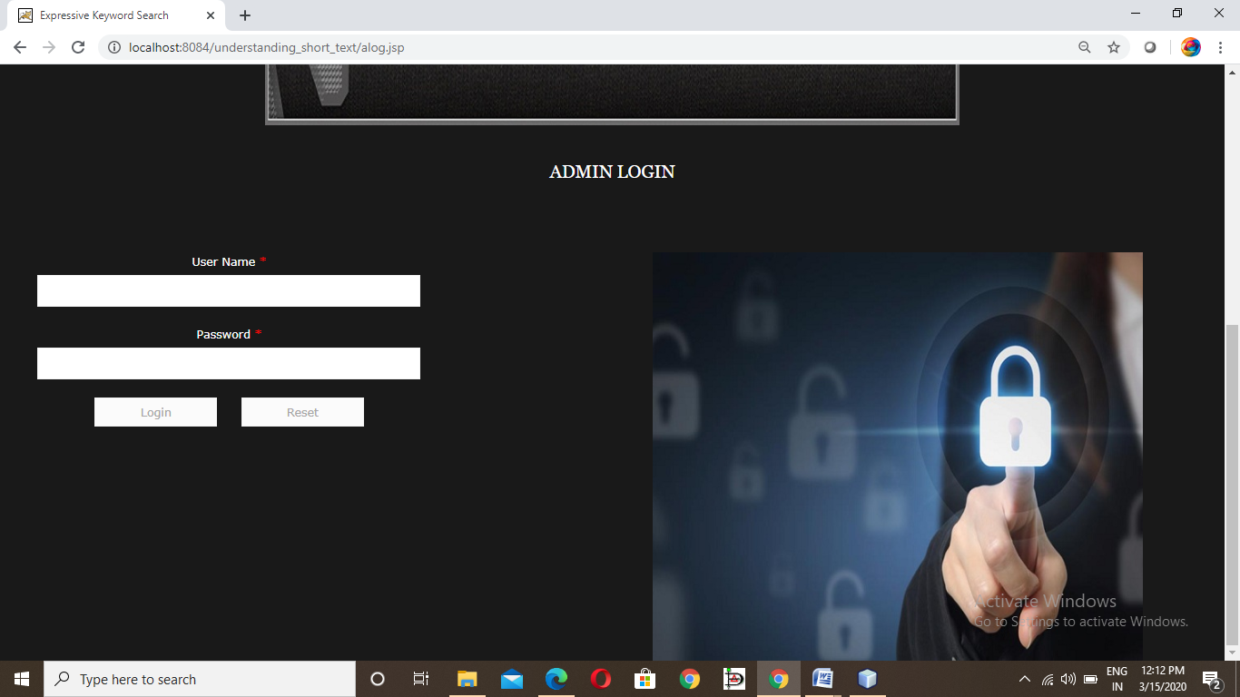
Outputs
Admin login

Slide 11
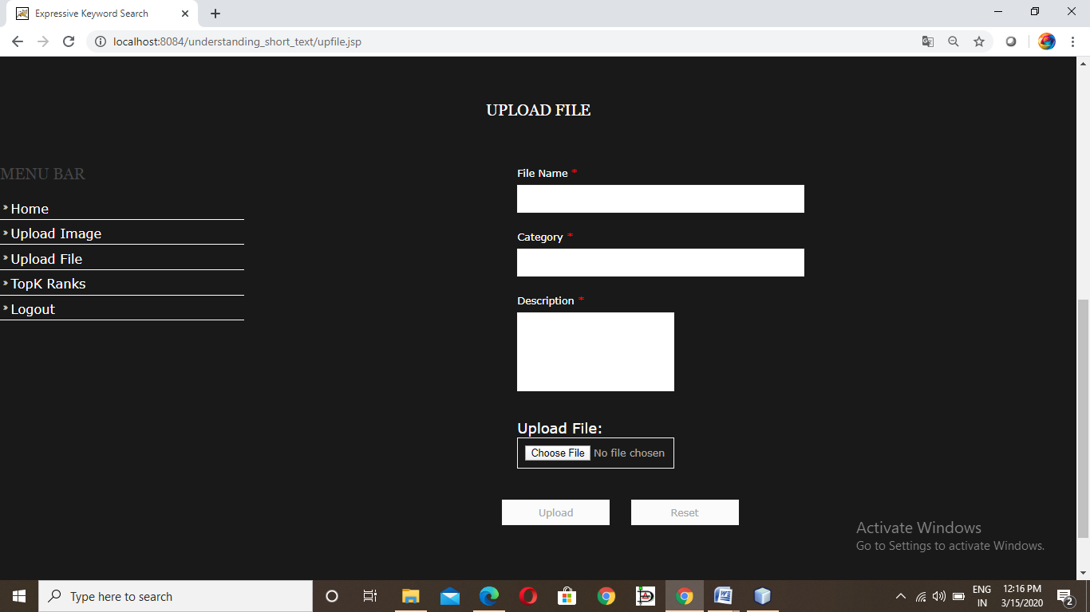
Upload files

Slide 12
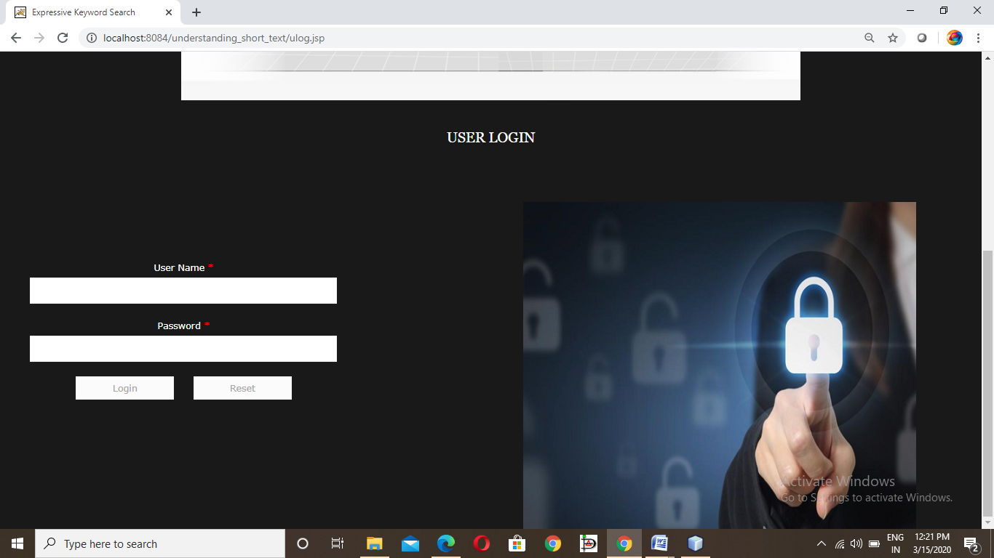
User login

Slide 13
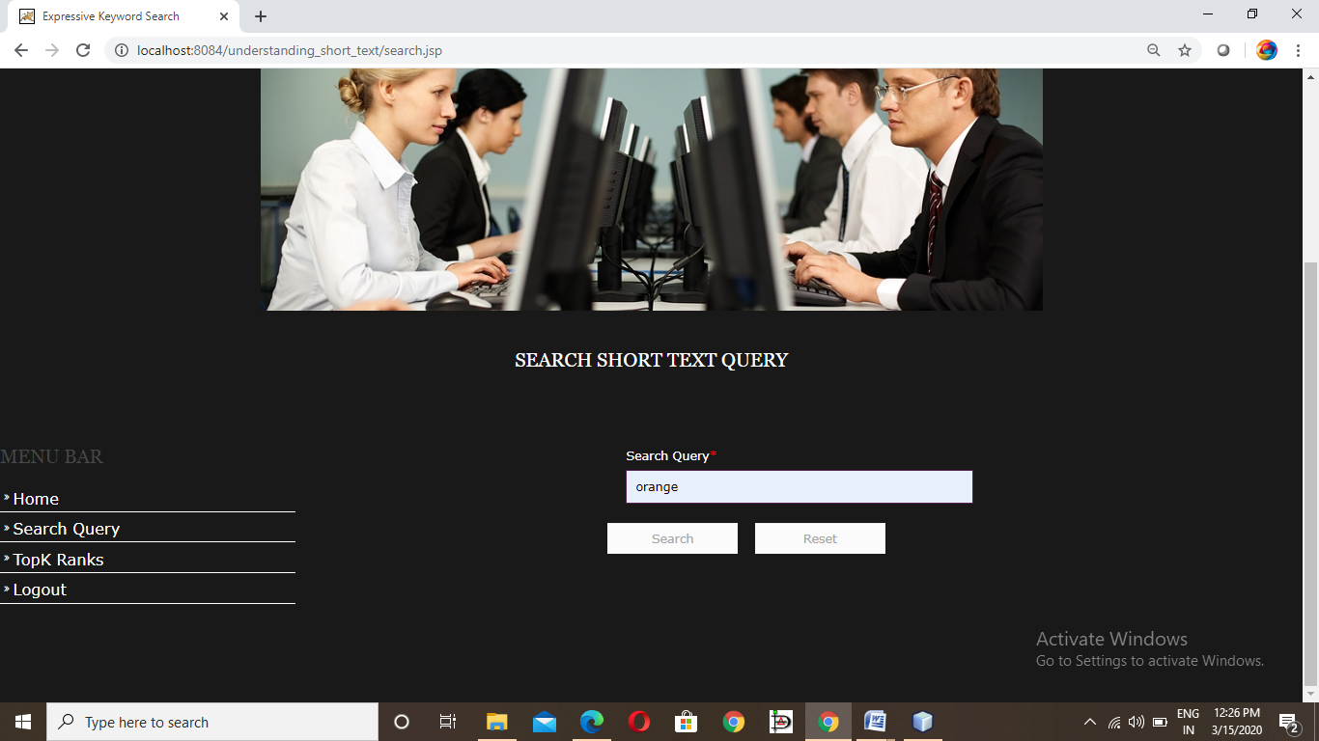
Search short text query

Slide 14
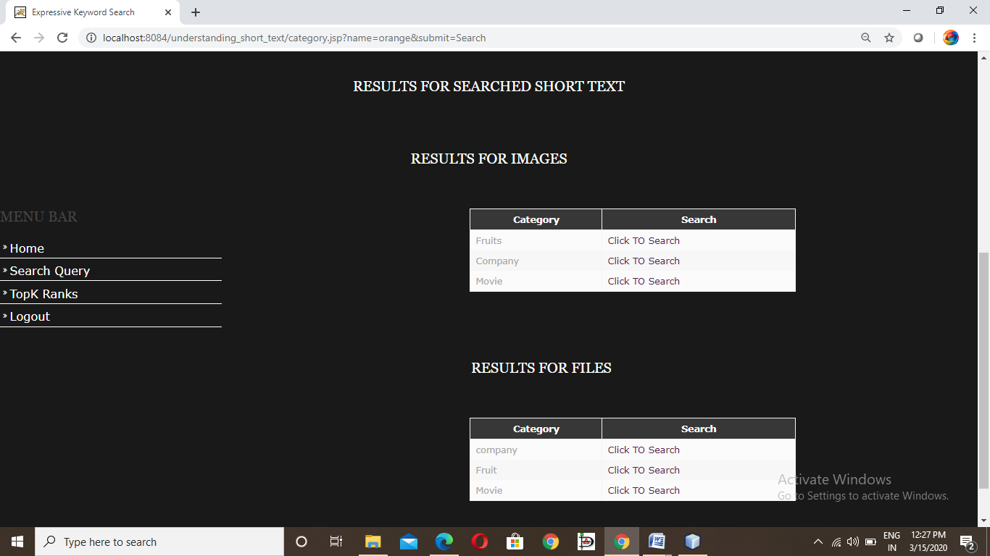
Results for searched short text query

Slide 15
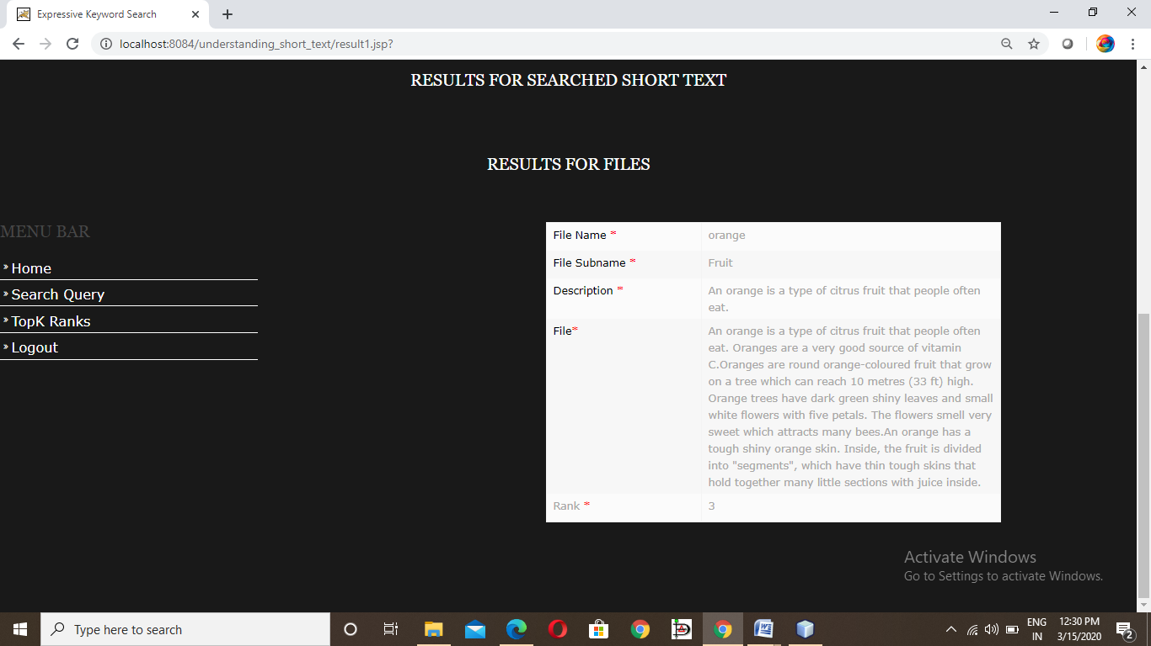
Results for files

Slide 16
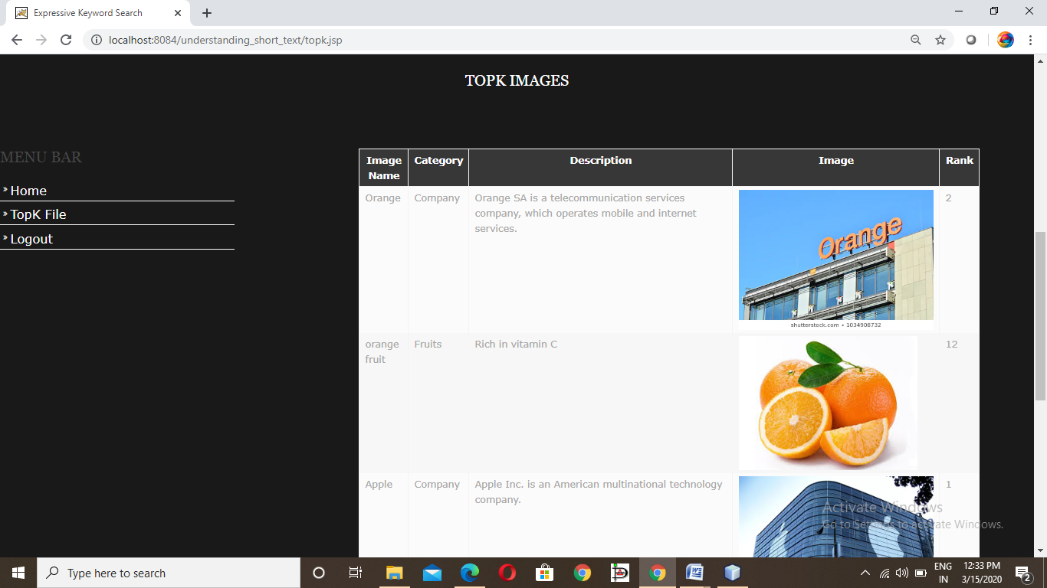
Topk images

Slide 17
Conclusion
Many approaches have been proposed to facilitate short text understanding by enriching the short text representations.
In this project we treat a short text as a query, we enrich it with search results (e.g., webpage titles and snippets) returned by a search engine.
We cluster the short text by their meaning. The output of the project is the search results clustered by their meanings and the user can retrieve the information as per his/her interest.

Slide 18
References
[1]Xuan-Hieu Phan, Le-Minh Nguyen,et.al.,” Learning to Classify Short and Sparse Text & Web with Hidden Topics from Large-scale Data Collections”, April 21-25, 2008 · Beijing, China.
[2]Y Krishna Priya, Dr.K.Venkata Ramana,” Semantic Enrichment of Short Texts through Conducive Formula”,Volume no:3,Issue no:6(November-2017).
[3]Justin Zhan, Binay Dahal,” Using deep learning for short text understanding” , published in the Journal of Big Data (Springer Paper) DOI 10.1186/s40537-017-0095-2 in 2017.

Slide 19
Thank you
Queries
?

